Slide 1


Slide 2
Idea/Approach Details
Problem Statement- Giving priority to emergency vehicle's at traffic lights.
Team Name- Morse Coders
Team Leader Name- Aadish Parashar

Slide 3
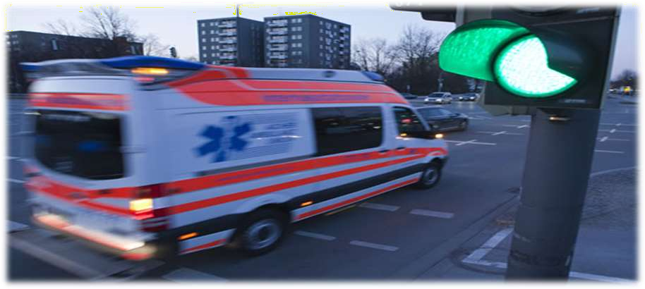
Intelligent Traffic Signal for Prioritized Vehicles using Object Detection

Slide 4
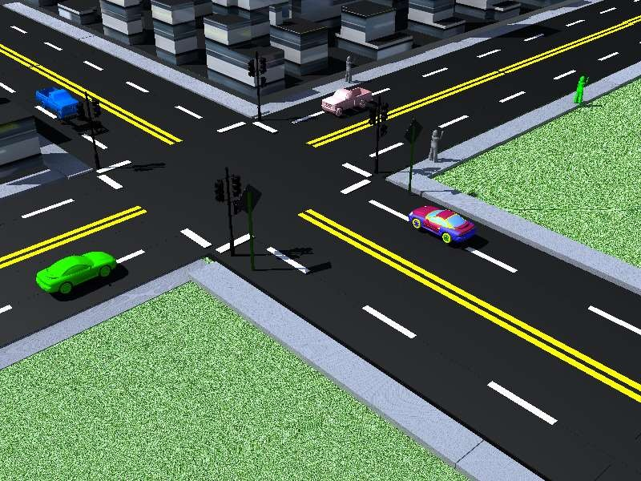
Generic Intersection design:-

Slide 5
Static Intersection Case:-
Present system is completely static case.
vehicles must wait at the intersection for a predefined time until microcontroller switches green light for that lane.
Exists no process of preemption.
No green light service for priority based vehicles.

Slide 6
Deep learning algos for image classification-
1.AlexNet
2.MobileNet
3.VGGNet
4.GoogleNet
Data set we are using here is -
1.ImageNet (1000 classes)
2.CoCo (80 classes)
Famous Algorithms-
1.YOLO V1, V2
2. SSD MobileNet V2
3. SSD MobileNet V3

Slide 7
Sound Sensors:
Road rule standard:
Emergency vehicles – Honk intensity:128dB
Transportation vehicles-Honk intensity:86dB
Acoustic sensing is possible by setting threshold detection value.
Thus differentiation is made between Transport & Emergency vehicles
Arranged up to 300 to 400 meters from the intersection.

Slide 8
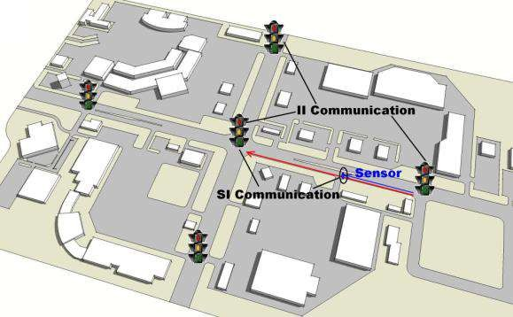
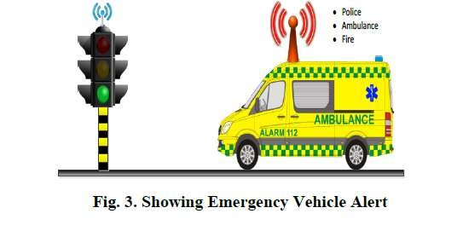
Sensor Detection & communication with neighbors:
Each road side sensor will
communicate with
controller.
Ever intersection will communicate with next intersection
Entire communication is carried out wirelessly using ISM band.

Slide 9
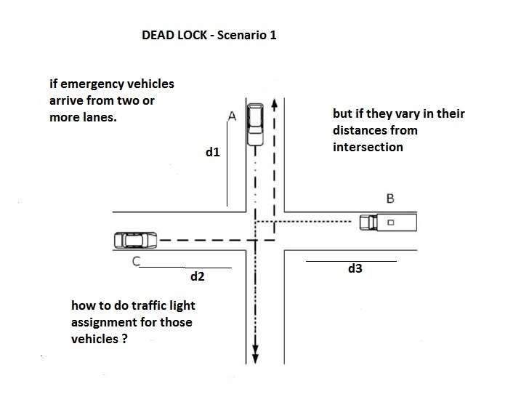
Dead lock scenario:

Slide 10
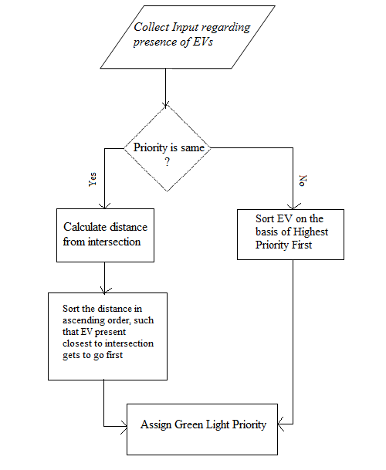
Solution :

Slide 11
Working-
When the camera and the sound sensor detects an approaching emergency vehicle it will inform the other traffic lights and turn that way's line to green or reduce their wait time . The same will be done as the vehicle approaches the next traffic light .

Slide 12



Team Members:-
Aadish Parashar
Tanush Dev
Shouzaf Zafar

